Slide 1
Error Handling
Think outside the object
Chris Johnson
Notes:
Breathe!!
Thanks for the introduction, and thanks to the team for organising the conference
Welcome to the session, I’m Chris, this talk is about SSDT database projects
Hopefully not expecting
- Changing the way we do DevOps for SQL Server – Aparna Knoduri
- Common ORM problems – Josh Darnell
Level of presentations so far from this side of the screen would describe as intimidatingly good
SECTION TIME: 4 mins

Slide 2

About Me
Chris Johnson [he/him]
SQL developer since 2006
Email: chris.johnson.0120@gmail.com
Blog: www.chrisjohnson120.com
GitHub: https://github.com/ChrisJohnson0120
Notes:
Before we launch into this properly, a bit about me
These are my contact details, contact me, I’m happy to help
Been a SQL dev for 15 years, and most of the companies I’ve worked for have a standard error handling template for stored procedures.
Every company has had a variation on the same core idea, and they all have the same flaw, so today..

Slide 3
Agenda:
Standard error template
What’s wrong with it?
How to fix it?
Notes:
I’m going to go through the standard error template, what’s wrong with it, and how we can fix it:

Slide 4
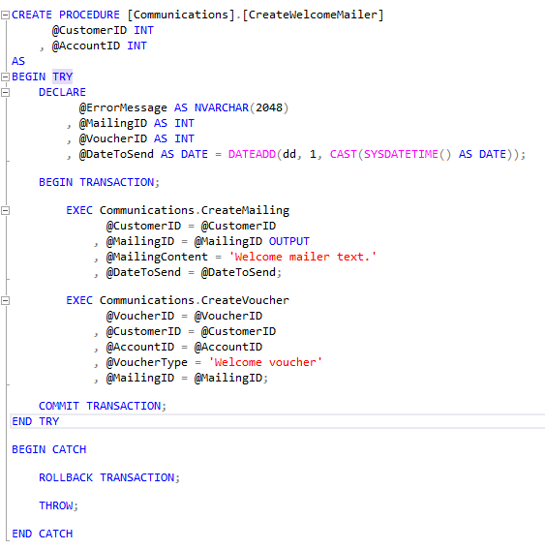
Standard template
Notes:
This stored proc creates a welcome mailer. To do this it creates a mailing, and then creates a welcome voucher attached to the mailing. The proc as a whole is maybe a little difficult to see on the screen, so let’s collapse those executions and look in a bit more detail…

Slide 5
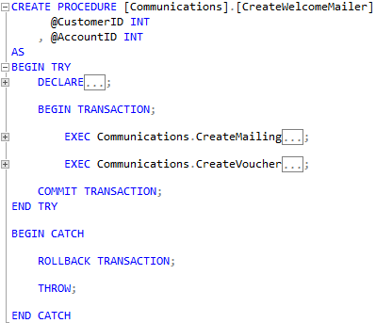
Standard template
Notes:
That’s a bit better.
Now, we’ve decided that if there’s a failure creating the voucher, it’s better to not create the mailer either. People are less upset by the welcome mailer not arriving than they are by getting an email talking about the welcome voucher when they don’t have the welcome voucher.
So, let’s see what happens if we execute this…

Slide 6
Standard template
Transaction Count = 0
Notes:
We declare the variables we need, and at this point the transaction count is 0 (apart from during the actual declare…

Slide 7
Standard template
Transaction Count = 1
Notes:
We begin the transaction, and the transaction count ticks up to 1…

Slide 8

Standard template
Transaction Count = 1
Notes:
We execute the create mailing stored proc…
And it succeeds…

Slide 9

Standard template
Transaction Count = 1
Notes:
We execute the create voucher stored proc…
And it fails…

Slide 10
Standard template
Transaction Count = 1
Notes:
So we jump to the catch block…

Slide 11
Standard template
Transaction Count = 1
Notes:
And roll back the transaction…

Slide 12

Standard template
Transaction Count = 1
Notes:
Which reverses the create mailing…

Slide 13
Standard template
Transaction Count = 0
Notes:
And sets the transaction count back to 0…

Slide 14
Standard template
Transaction Count = 0
Notes:
And finally we throw the error to whatever called this stored proc, so it can decide what to do next.

Slide 15
What’s the issue?
Notes:
So, that’s all great, right?
Well, yes, if we just look at this object.
But what if we zoom out and look at the system as a whole…

Slide 16
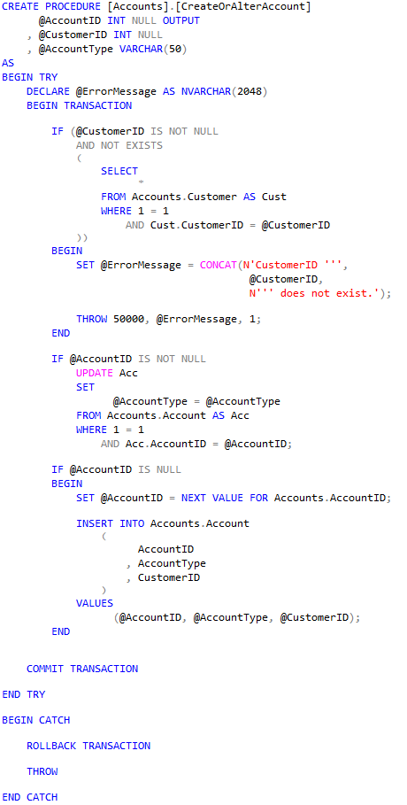
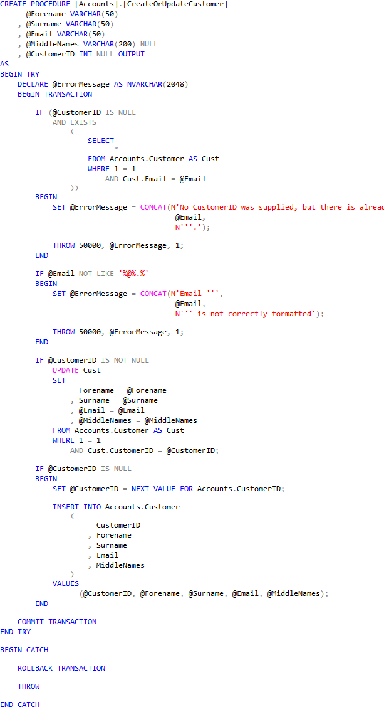
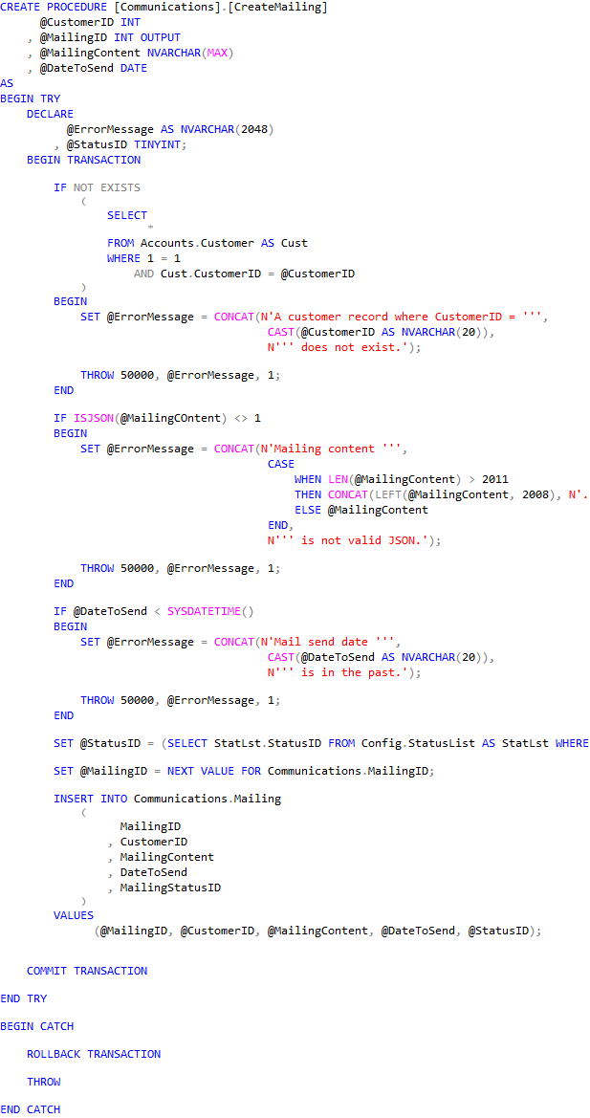
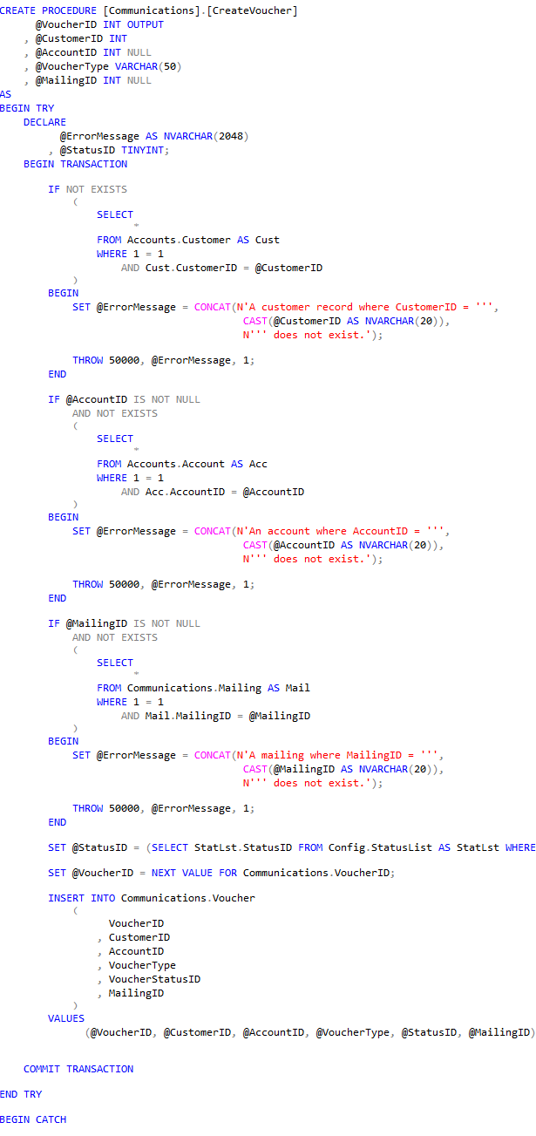
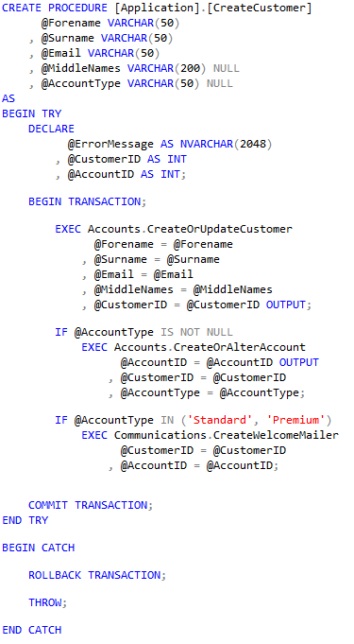
What’s the issue?
Notes:
There are a number of procedures in our system, and some of them call each other.
Let’s take a look at another procedure...

Slide 17
What’s the issue?
Notes:
This proc calls our CreateWelcomeMailer, as part of a CreateCustomer process. We can clean it up the same was as we did previously..

Slide 18
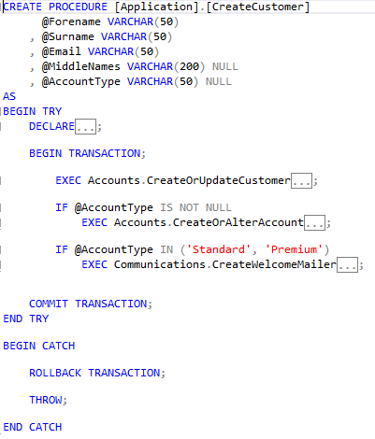
What’s the issue?
Notes:
Here, we can see our proc creates a customer, an account, and then creates a welcome mailer for them, provided the account type is correct. So let’s step through this like we did before…

Slide 19
What’s the issue?
Transaction Count = 0
Notes:
We start with a transaction count of 0

Slide 20
What’s the issue?
Transaction Count = 1
Notes:
We begin the transaction

Slide 21
What’s the issue?
Transaction Count = 1
Notes:
We create the customer successfully

Slide 22
What’s the issue?
Transaction Count = 1
Notes:
And create the account successfully…

Slide 23
What’s the issue?
Transaction Count = 1
Notes:
And start to execute the CreateWelcomeMailer proc…

Slide 24
What’s the issue?
Transaction Count = 1
Notes:
And start to execute the CreateWelcomeMailer proc…

Slide 25
What’s the issue?
Transaction Count = 2
Notes:
As we step through this proc the transaction count gets set to 2…

Slide 26

What’s the issue?
Transaction Count = 2
Notes:
We create the mailer successfully…

Slide 27
What’s the issue?
Transaction Count = 2
Notes:
But the voucher create fails again…

Slide 28
What’s the issue?
Transaction Count = 2
Notes:
So we skip to the catch block, and start the rollback, but this time we don’t stop at this procedure…

Slide 29

What’s the issue?
Transaction Count = 1
Notes:
Because once it’s rolled back the transaction count is still 1…

Slide 30
What’s the issue?
Transaction Count = 1
Notes:
So the rollback keeps going into the parent procedure…

Slide 31
What’s the issue?
Transaction Count = 1
Notes:
So the rollback keeps going into the parent procedure…

Slide 32
What’s the issue?
Transaction Count = 0
Notes:
And finally stops here, when the transaction count hits 0, but even then we aren’t done…

Slide 33
What’s the issue?
Transaction Count = 0
Notes:
The throw throws the error to the parent proc…

Slide 34
What’s the issue?
Transaction Count = 0
Notes:
So the parent proc switches to the catch block, and tries to roll back…
But there is no active transaction, so the rollback errors…
which means everything stops at that point.
No THROW of the proper error

Slide 35
What’s the issue?
Notes:
All the caller is going to see is an error about how the rollback failed, they’re not going to see what caused the CreateVoucher proc to fail.
Also, what if the parent proc doesn’t want to fail if the child proc fails, what if the parent proc is doing something else like…

Slide 36
What’s the issue?
Notes:
All the caller is going to see is an error about how the rollback failed, they’re not going to see what caused the CreateVoucher proc to fail.
Also, what if the parent proc doesn’t want to fail if the child proc fails, what if the parent proc is doing something else like…

Slide 37
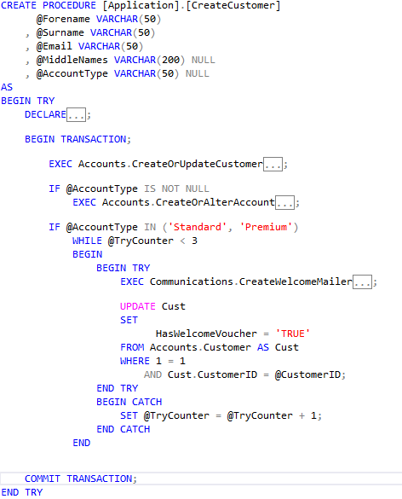
What’s the issue?
Notes:
Here, where we know that procedure fails a lot due to deadlocking issues. So we’ve coded something in to try it 3 times, and if it still fails we have a flag against the customer to say if the welcome voucher has been sent or not. This way we can still create the customer, and every day we can check which customers don’t have a welcome voucher and manually send one. Bit of a hack, but it gets the job done, except that on the first failure to create the welcome mailer we also roll back the customer creation in this parent proc.

Slide 38
What’s the issue?
Notes:
Here, where we know that procedure fails a lot due to deadlocking issues. So we’ve coded something in to try it 3 times, and if it still fails we have a flag against the customer to say if the welcome voucher has been sent or not. This way we can still create the customer, and every day we can check which customers don’t have a welcome voucher and manually send one. Bit of a hack, but it gets the job done, except that on the first failure to create the welcome mailer we also roll back the customer creation in this parent proc.

Slide 39
What’s the issue?
Notes:
Here, where we know that procedure fails a lot due to deadlocking issues. So we’ve coded something in to try it 3 times, and if it still fails we have a flag against the customer to say if the welcome voucher has been sent or not. This way we can still create the customer, and every day we can check which customers don’t have a welcome voucher and manually send one. Bit of a hack, but it gets the job done, except that on the first failure to create the welcome mailer we also roll back the customer creation in this parent proc.

Slide 40
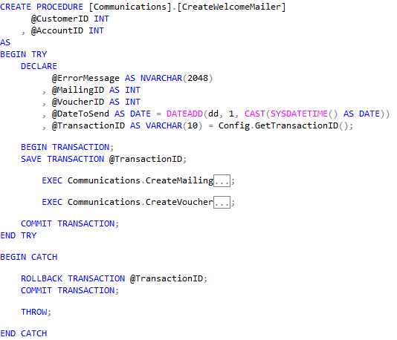
What’s the solution?
Notes:
Adopt a pattern like this instead
At the start of a proc, create a named save point immediately after creating the transaction, I like to use a sequence object converted to a varchar, but you can come up with any way to create a random name
If there’s an issue, roll back to that save point
You will still have an open transaction so you need to run a commit, but you will only be committing that empty space between the begin and the save transaction.

Slide 41
What’s the solution?
Warning!
ROLLBACK to save point does not affect transaction count
BEGIN > SAVE X > BEGIN > ROLLBACK X
Transaction Count = 2
Notes:
Quick warning here

Slide 42
Why not name the transaction
Named transactions are a lie
Can only name outer transaction
ROLLBACK will fail

Slide 43
Any Questions?
Email: chris.johnson.0120@gmail.com
Blog: www.chrisjohnson120.com
GitHub: https://github.com/ChrisJohnson0120
Please get in touch
Notes:
Thank you to Ben and William for organising the event
And to all the hard-working volunteers behind the scenes
Thank you all for listening
Contact details are on the screen, reach out if you have any further questions, and I hope this has been useful.
Have a great weekend and hopefully we’ll all be back to doing this in person sometime soon.

